Slide 1
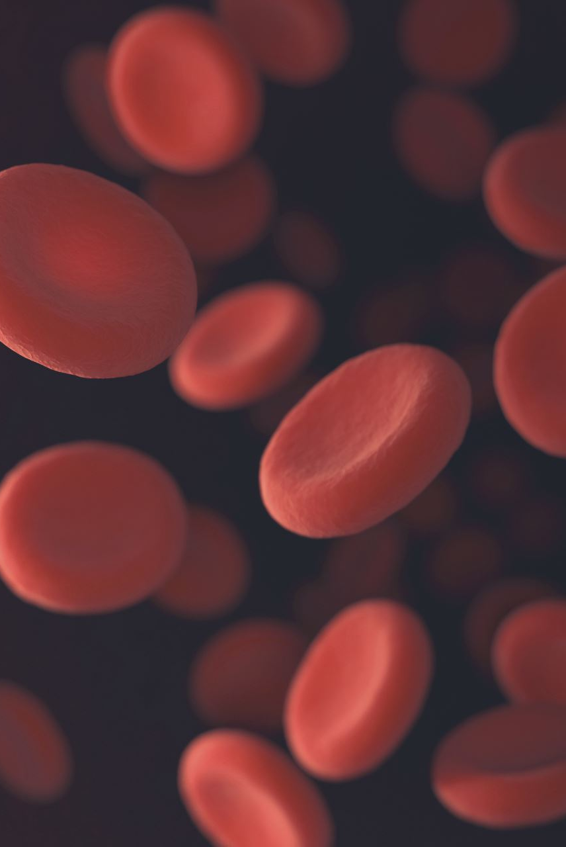
Blood Glucose Prediction
Opencampus - Advanced Time Series
WiSe 24/25
Anna Dahlhaus, Christopher Kunze, Tim Oldörp, Leo Simak

Slide 2
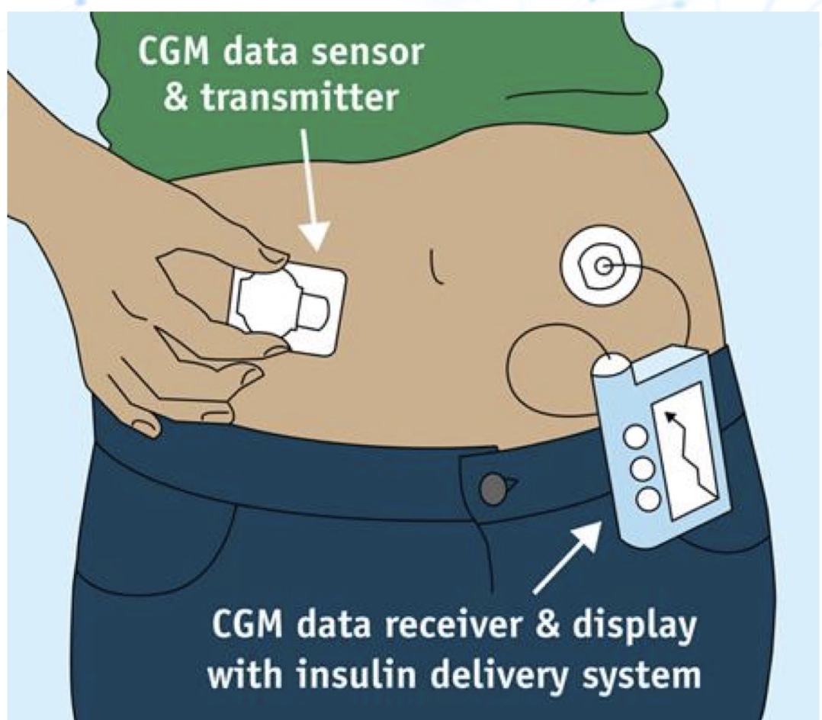
Introduction
Task:
Predict future blood glucose values
Dataset: HUPA-UCM Diabetes Dataset:
25 people with Type 1 Diabetes Mellitus (T1DM)
Continuous Glucose Monitoring (CGM) data over several days (>7d)
Fitness tracker data: Steps, Heart rate, Burned calories, (sleep)
Carbohydrate intake & Insulin dosages (Basis + Bolus)

Slide 3
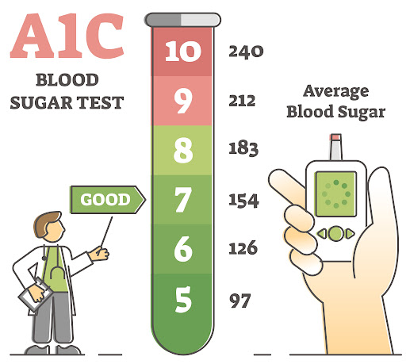

Basic Domain Knowledge Blood Glucose
Blood Glucose (BG)
Glucose (C₆H₁₂O₆.) is a simple sugar (monosaccharide) that serves as a primary source of energy for the body's cells.
Levels of glucose in the bloodstream is regulated by the two hormones Insulin (BG$↓)$ and Glucagon (BG $↑$) released in the pancreas
Blood Glucose Levels in T1D
Normal fasting blood glucose:
70–100 mg/dL (3.9–5.6 mmol/L).
Hyperglycemia (high blood sugar):
>180 mg/dL (10 mmol/L).
Hypoglycemia (low blood sugar):
<70 mg/dL (3.9 mmol/L).

Slide 4
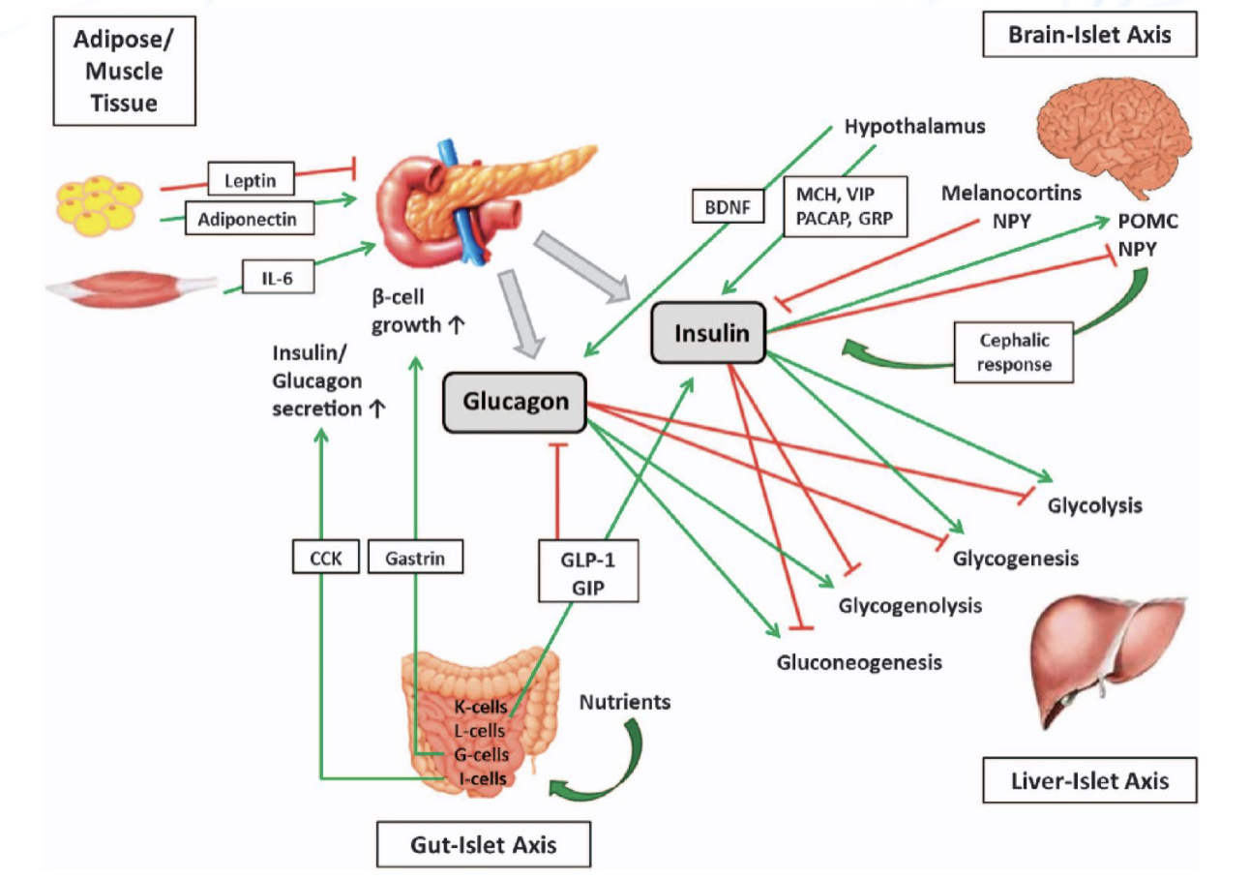
Type 1 Diabetes Mellitus (T1DM)
70-120
<70
>180
Autoimmune disease : Immune system destroys the insulin-producing beta cells in the pancreas
Without insulin, the body cannot regulate blood glucose levels effectively
Therapy:
Administering insulin (via injections or pumps):
Basal insulin: longterm basis
Bolus insulin: short term before meals
Monitoring blood glucose levels
Balancing carbohydrate intake, physical activity, and medication
Regular monitoring helps prevent complications like heart disease, nerve damage, and kidney problems.

Slide 5
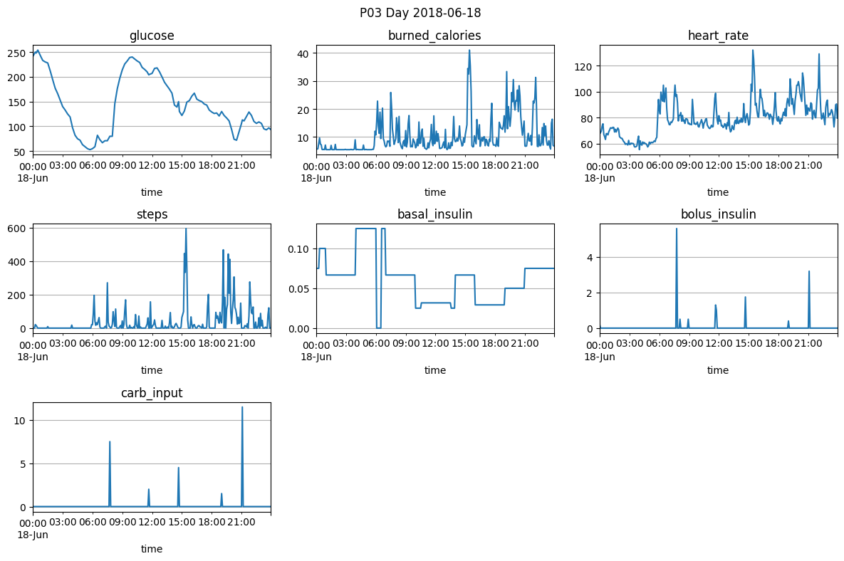
HUPA-UCM Diabetes Dataset
25 subject, multiple days each (>7d)
Preprocessed 5-min data for glucose, insulin doses, carb intake & metabolic markers

Slide 6
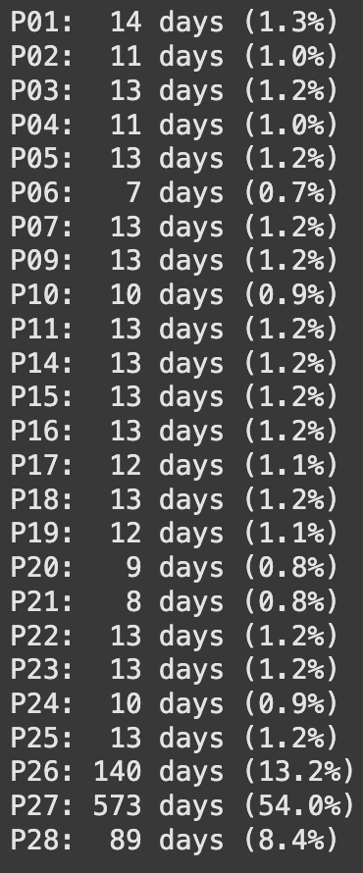
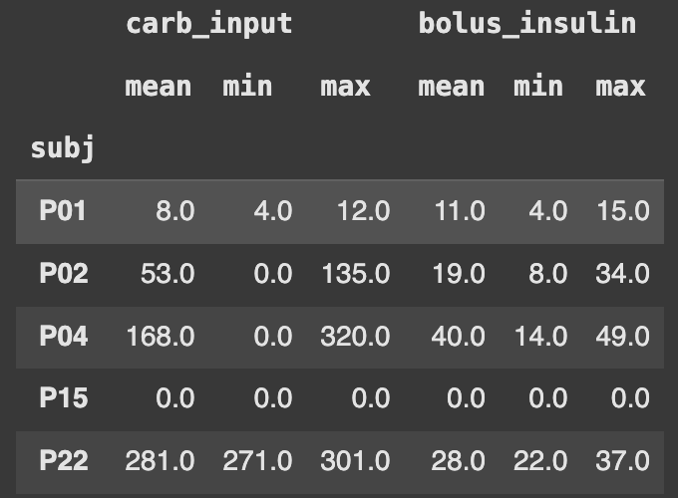
Exploratory data analysis
Vastly imbalanced data between subjects!
> 50% of the dataset is just one subject: P27
~75% is from P26, P27 or P28
All other just contribute ~1% each
Data quality is mixed 😕
Missing data: e.g. P15 has no tracking of carb_input nor bolus_insulin
Carb_input has different scales between subjects (µ = 8 vs. µ=281)

Slide 7
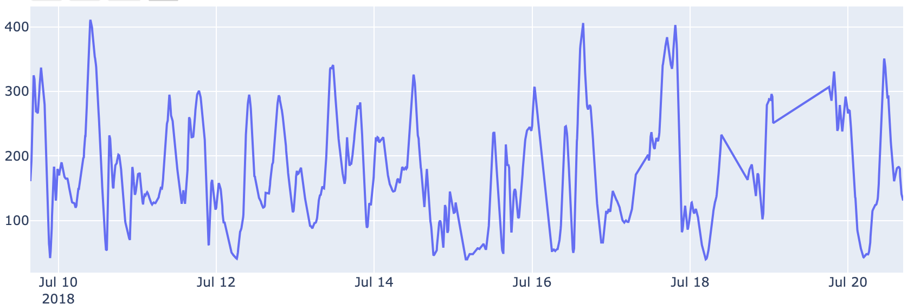
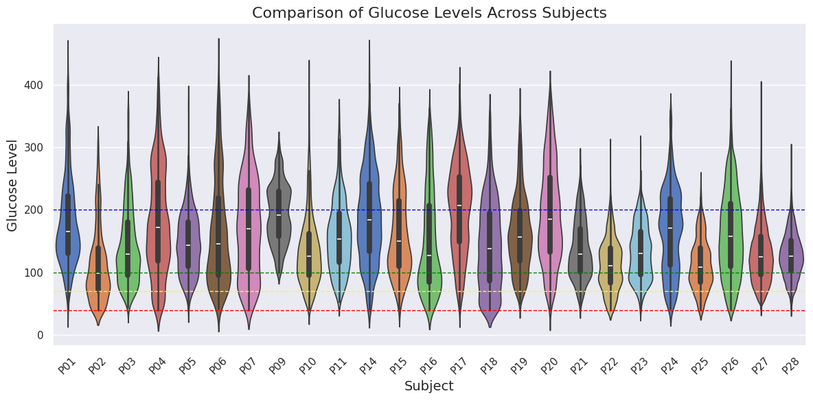


Target: Glucose
Glucose levels P04
Severe cases of hypoglycemia and hyperglycemia present
Missing data was linearly interpolated
Big interindividual differences in therapeutic success

Slide 8
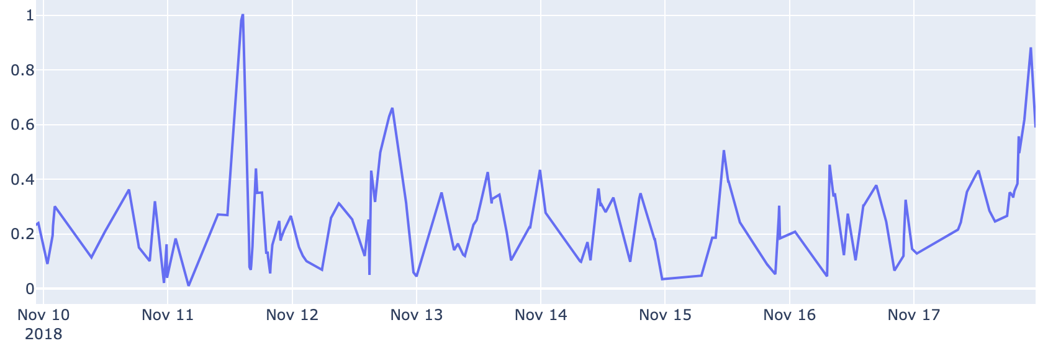
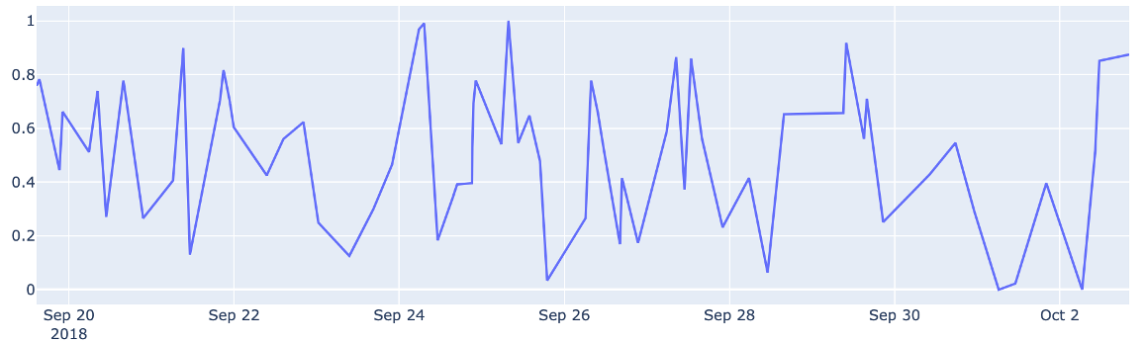
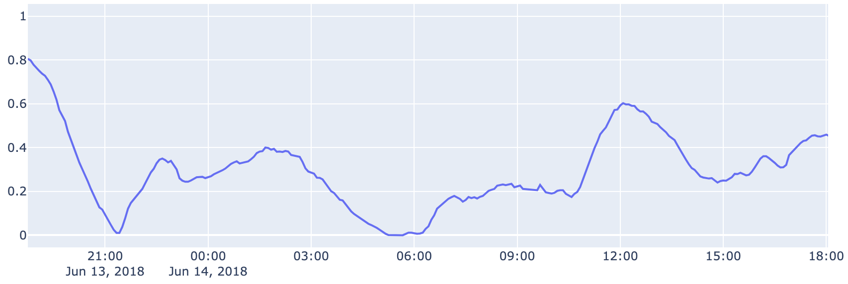
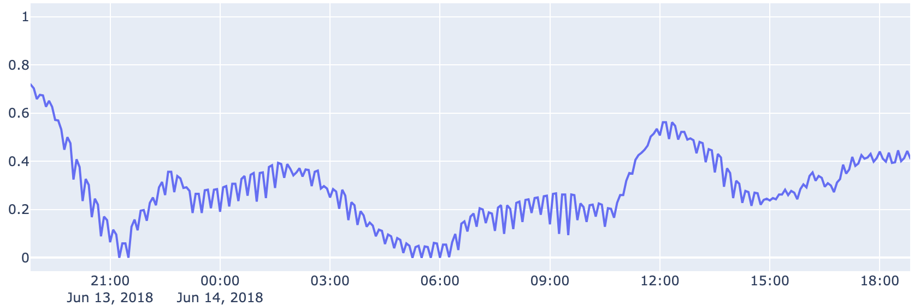
Problems
Glucose levels P09
2 subjects (P09 & P10) have extremely low measurement frequency
Bad quality!
➔ Delete from dataset
Subject P01 has weird ripple effect
interpolation artifact?
➔ MA-smoothed
Glucose levels P10
Glucose levels P01

Slide 9
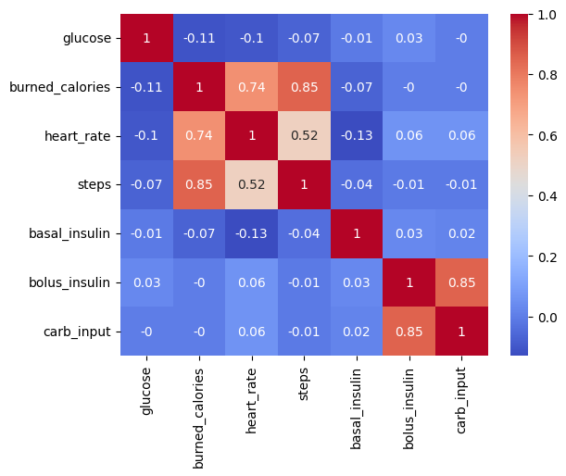
Feature Correlation
Some features are strongly correlated
Bolus insulin is given before meals and is thus dependent on carb input
Burned calories, heart rate and steps were all measured using a fitness tracker. Burned calories were properly approximated using heart rate and steps
Only linear dependence captured

Slide 10
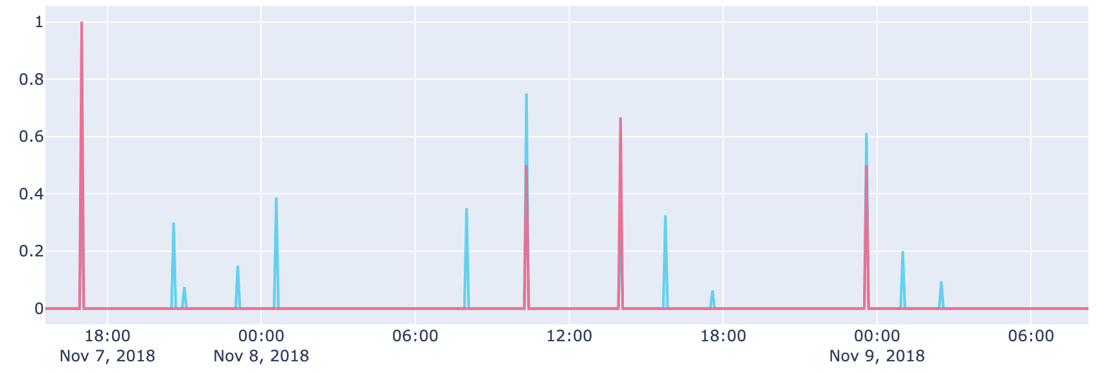

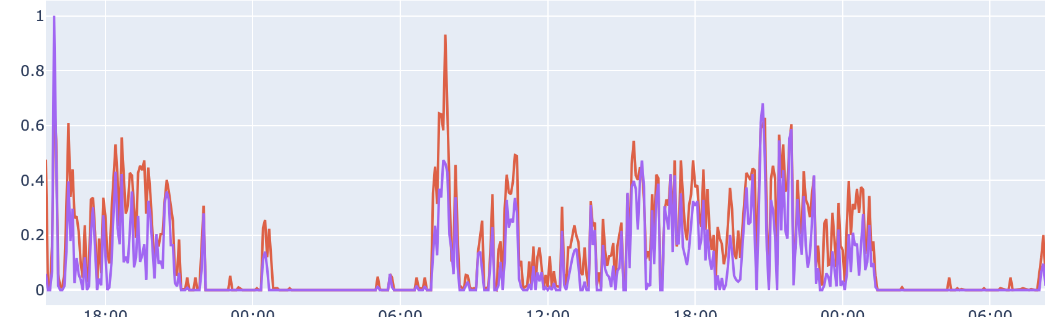
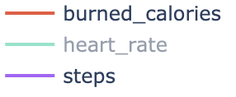
Feature selection
Carb input removed
Strong correlation with bolus insulin but worse data quality
Steps removed
Strong correlation with burned calories (basis of approximation)
New feature time_of_day: sin/cos encoded
→ To capture circadian rhythm

Slide 11
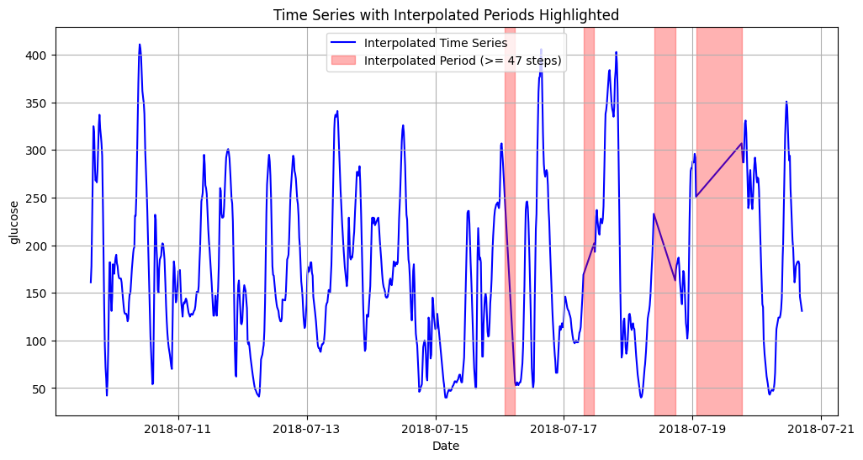
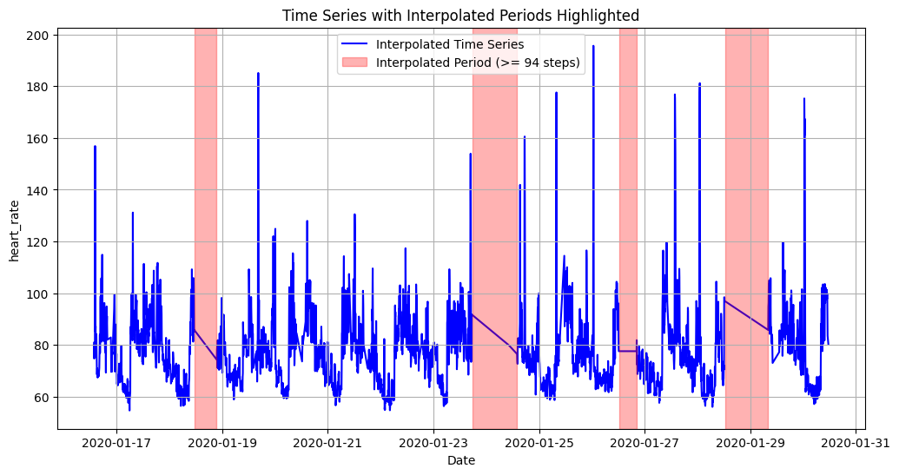
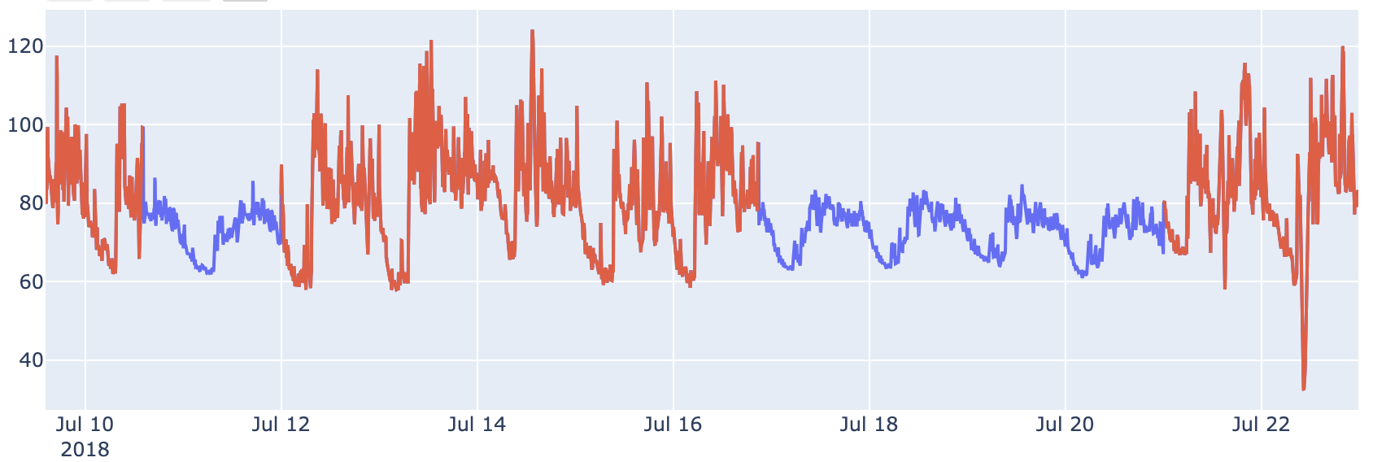
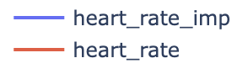
Interpolated data
Missing data were not marked but either set to zero (carb, insulin, steps, calories) or linearly interpolated (heart rate, glucose)
Detected using smoothing threshold (2nd derivative)
“Multiple Imputation with Chained Equations” was used to impute missing heart rate measurements
Glucose imputation: Mean value

Slide 12
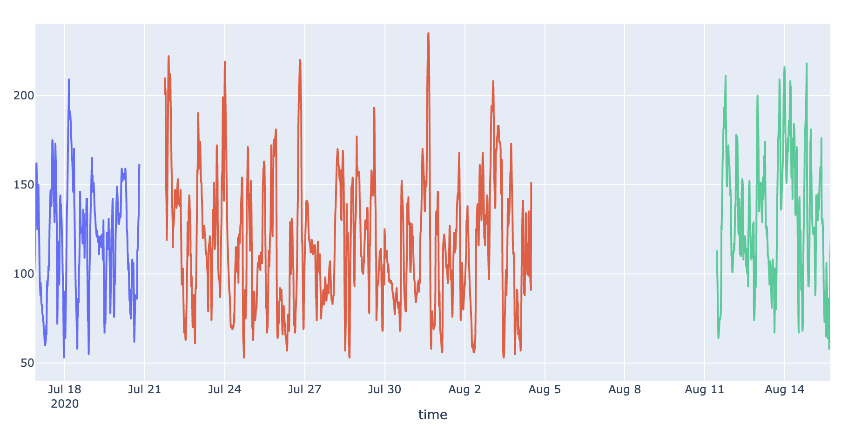
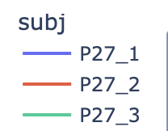
Split patients on big gaps?
Gaps >12h or more

Slide 13
evaluation
Task 1 - Predict the glucose level 1h in advance for one subject
1a: Training on the same subject’s data
1b: Training augmented with other subjects’ data
Task 2 - Predict the glucose level 1h in advance for multiple subject
2a: Training on one other subject’s data
2b: Training on other subjects’ data
P27
P27
P27
P_Train
P27
P27
P_Test
P27
P_Train
P_Test
Task 1a
Task 1b
Task 2a
Task 2b

Slide 14
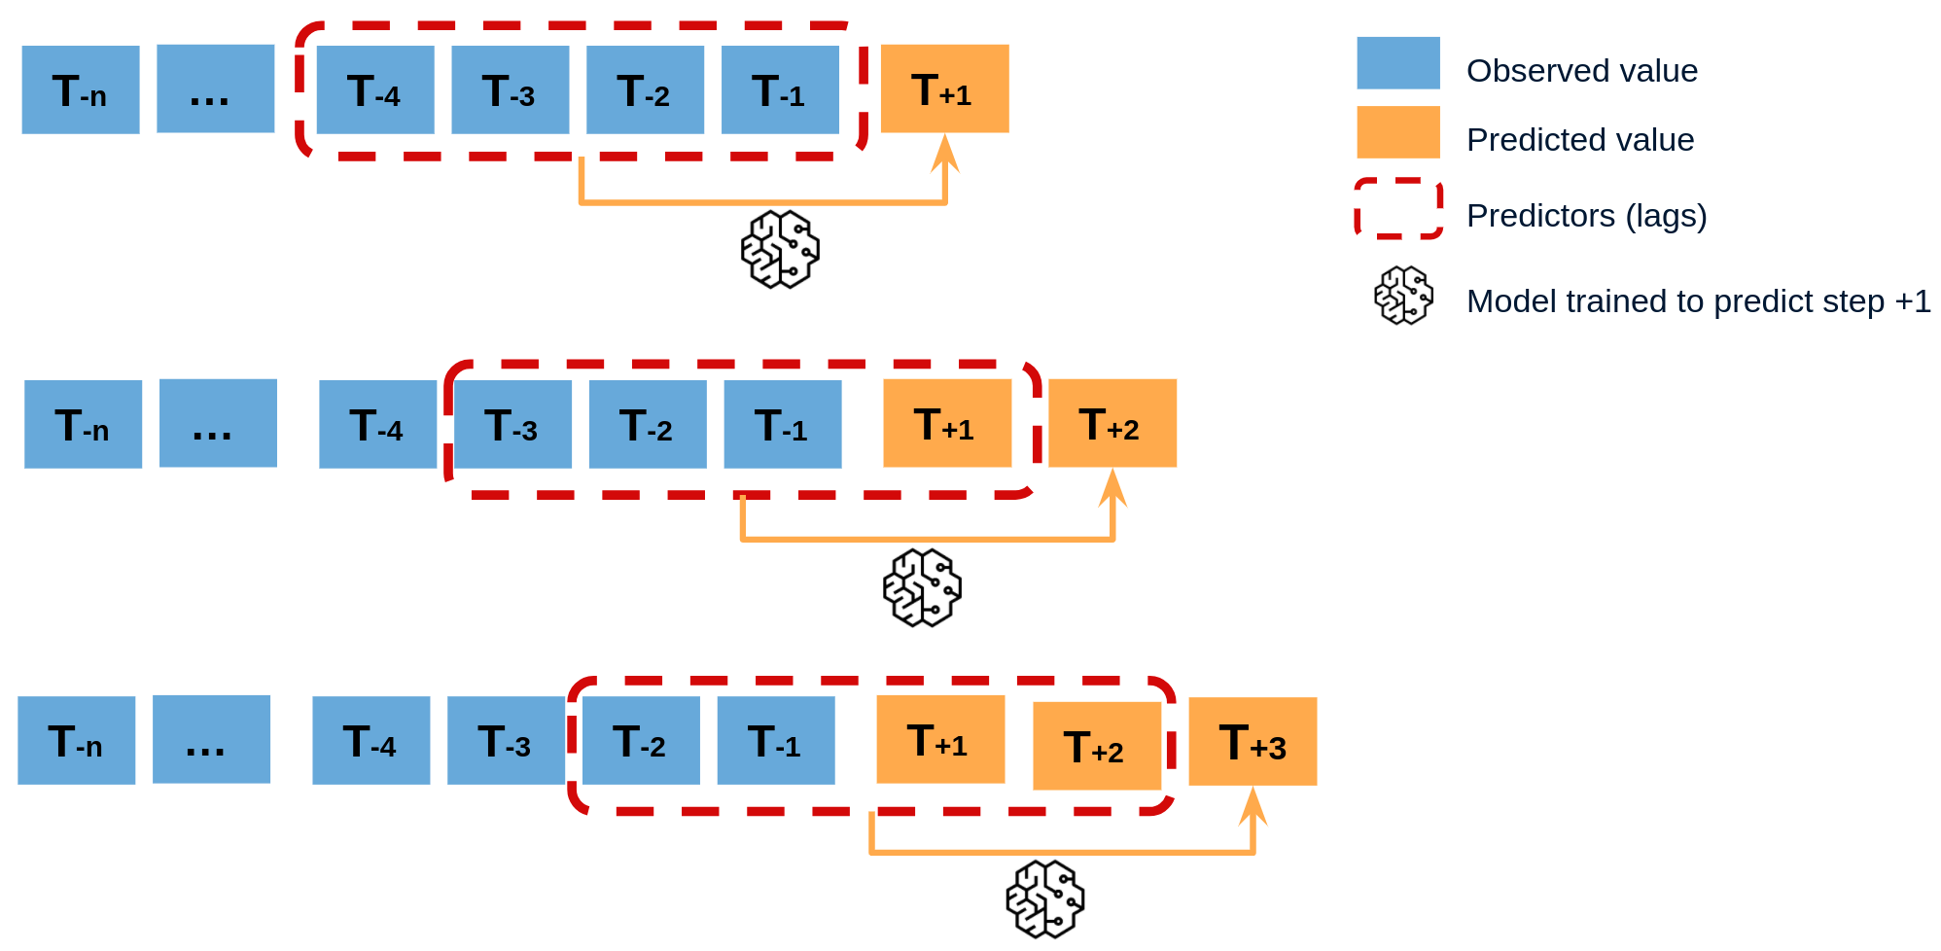

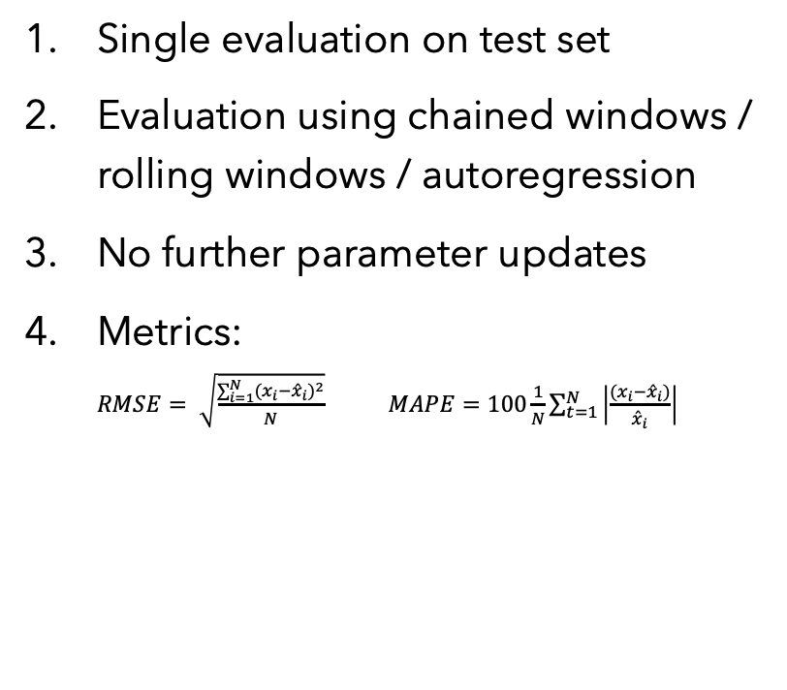
Evaluation rules
Single evaluation on test set
Evaluation using chained windows / rolling windows / autoregression
No further parameter updates
Metrics: $RMSE= \sqrt{\frac{\sum_{i=1}^{N}{{{(x}_{i}−{\hat{x}}_{i})}^{2}}}{N}}$ $MAPE=100\frac{1}{N}\sum_{t=1}^{N}{\left|\frac{{(x}_{i}−{\hat{x}}_{i})}{{\hat{x}}_{i}}\right|}$
1 time use
Train data
Test data
Val data
∞

Slide 15
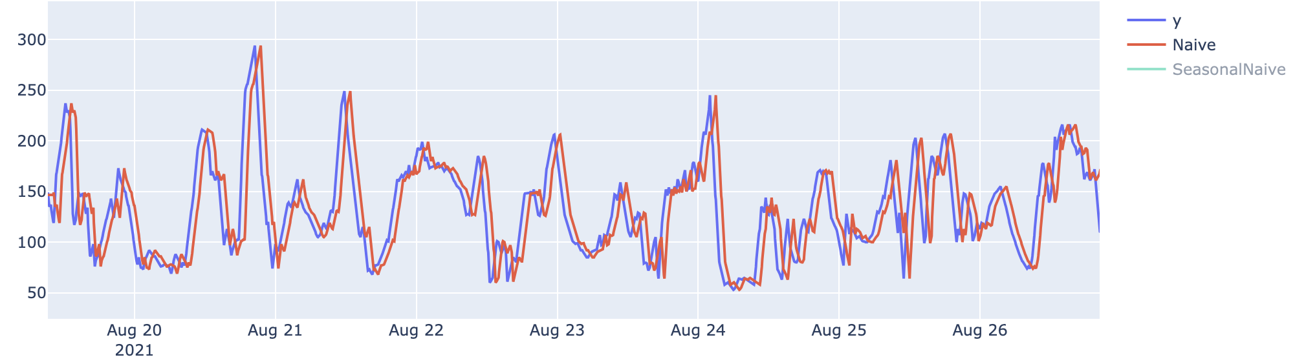
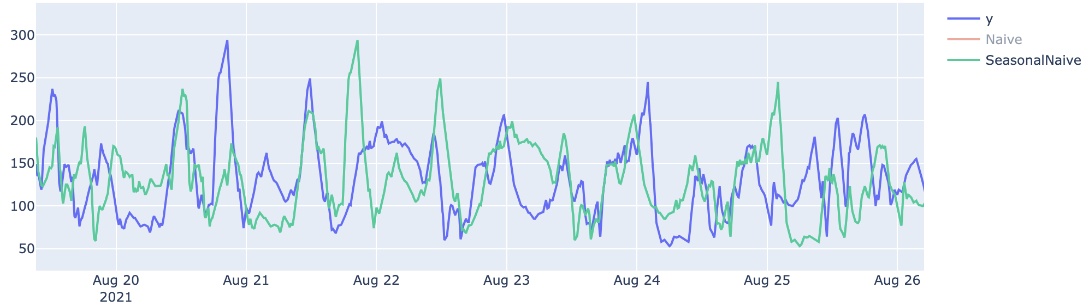
Baseline Model: (Seasonal)Naive
Naïve model - All forecasts have the value of the last observation (aka shift data by 1h)
Season naïve - All forecasts have the value shifted by one season (e.g. 24h)
Naive | RMSE | MAPE
Task 1* | 28.2 | 16.9%
Task 2* | 48.2 | 25.2%
*no difference between a and b
S-Naive | RMSE | MAPE
Task 1* | 63.0 | 42.5%
Task 2* | 86.0 | 51.2%
*no difference between a and b

Slide 16
Next step
Maybe using several previous values?
Different weighting?
Smoothing?
Combinging lags and seasonality?
➔ That’s an (S)ARIMA model ;)

Slide 17
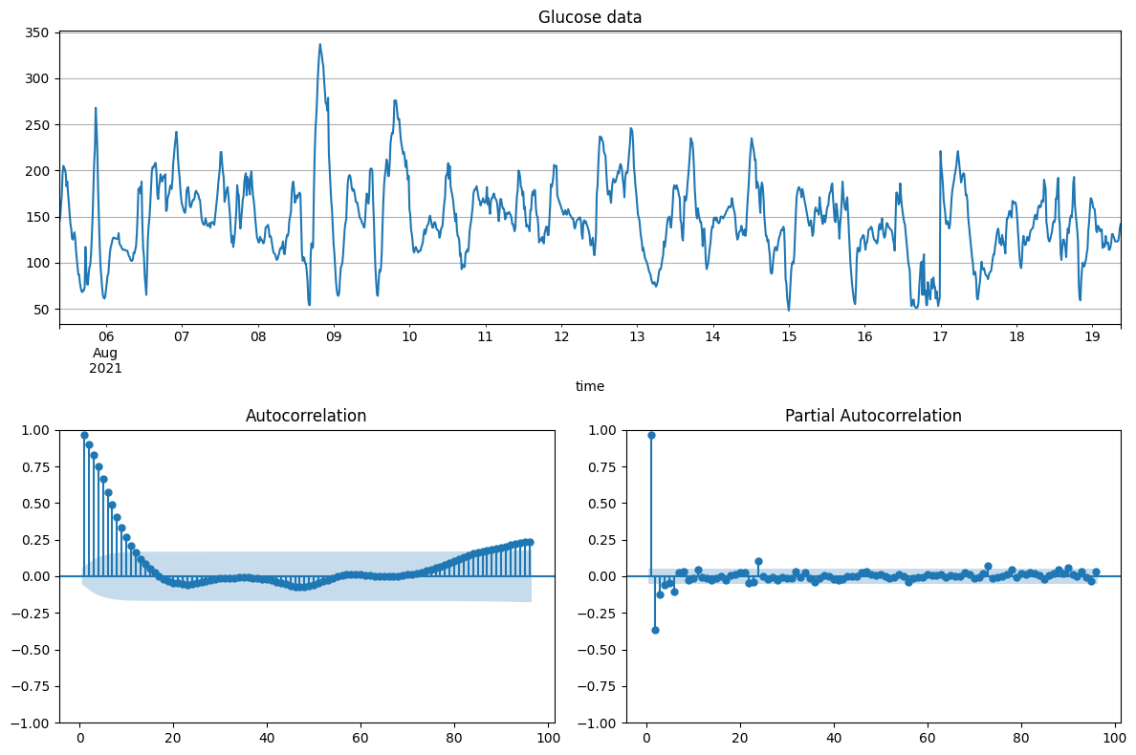
Arima & SARima
ADF-Test: p<0.000 → no unit-root
2 big PAC-components
ACF properly mainly propagation of the autocorrelation at lag-1 and lag-2
Check different orders:
e.g. (2,0,0) -- (2,0,1) -- (3,0,0) -- (1,1,2)
Try to include a seasonality:
One day (24h) or half a day(12h)
0 6 12 18 24
lag in [h]
0 6 12 18 24
lag in [h]

Slide 18
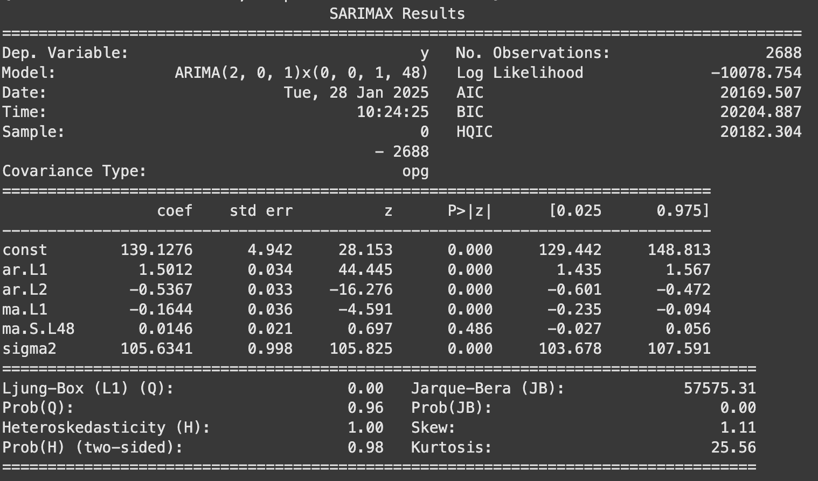
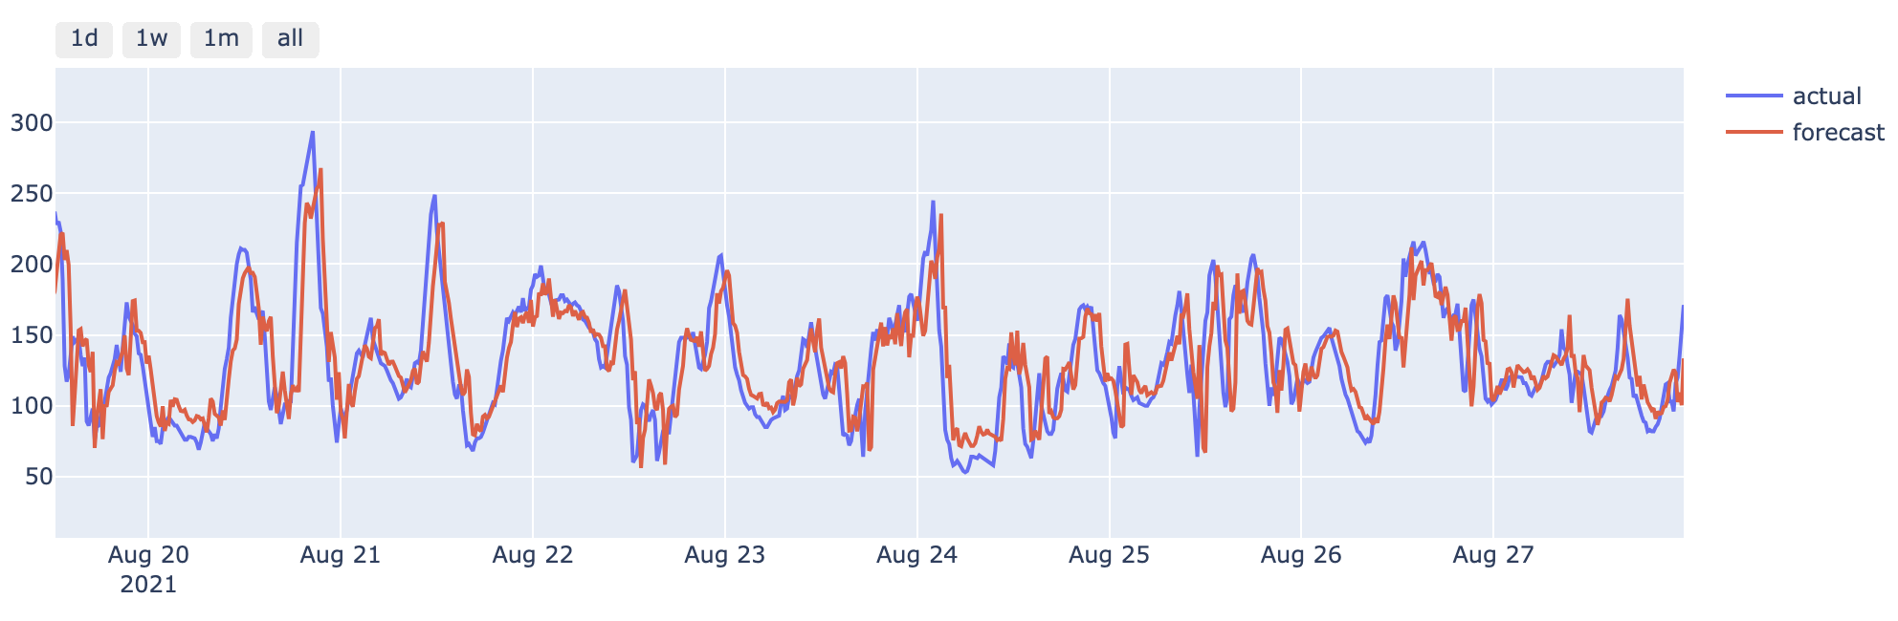
ARIMA - results
Best model:
Order: (2,0,1) x (0,0,1,12h)
Worse than naïve?!
Naive | RMSE | MAPE
Task 1* | 25.9 | 17.4%
Task 2*

Slide 19
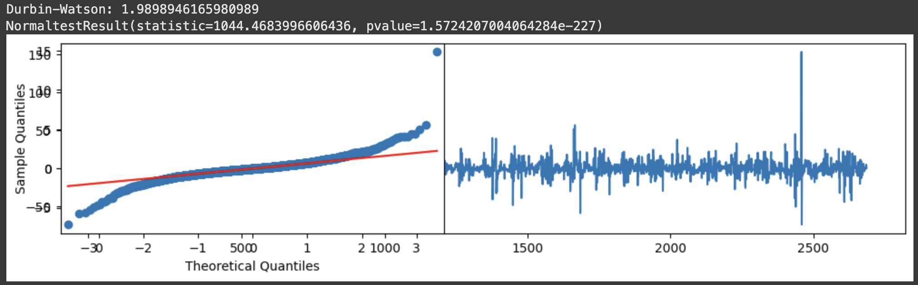
Arima - details
Not an optimal fit:
Non-normally distributed error

Slide 20
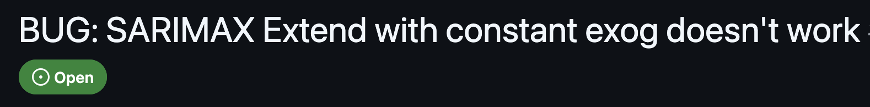
Arima-X: Using exogenous features?
Some technical problems....

Slide 21
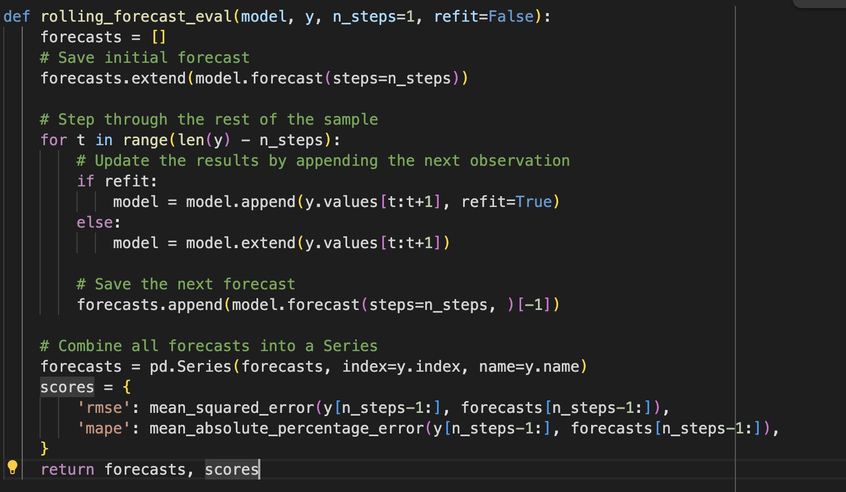
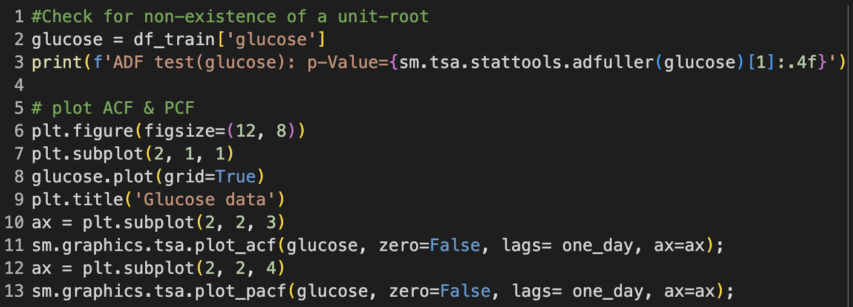
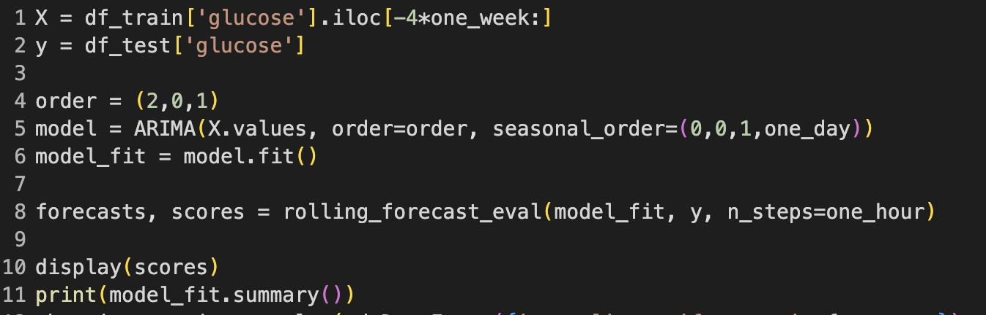
ARIMA – Code snippets
Implemented using statsmodels

Slide 22
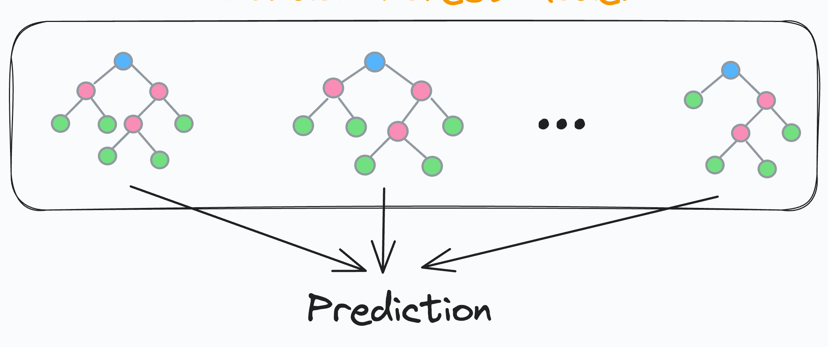
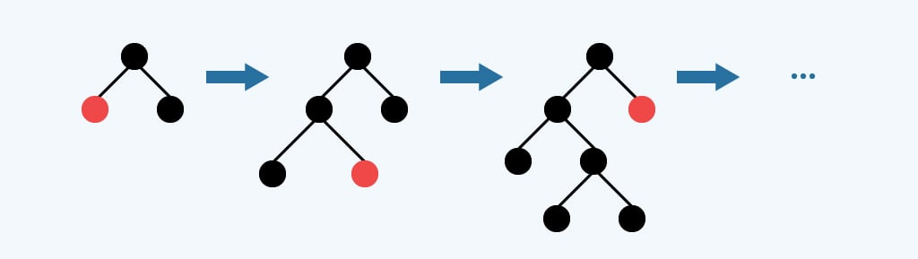
Regression Tree ensembles boosting & Baggging
Why?
Handle non-linear relationships well
Provide feature importance rankings
Less prone to overfitting due to ensemble nature
Work well with numerical time series data
Feature engineering:
Time features:
time of day (sin/cos), day of week, month
Lag features:
6h lag
Glucose level, heart rate, insulin

Slide 23
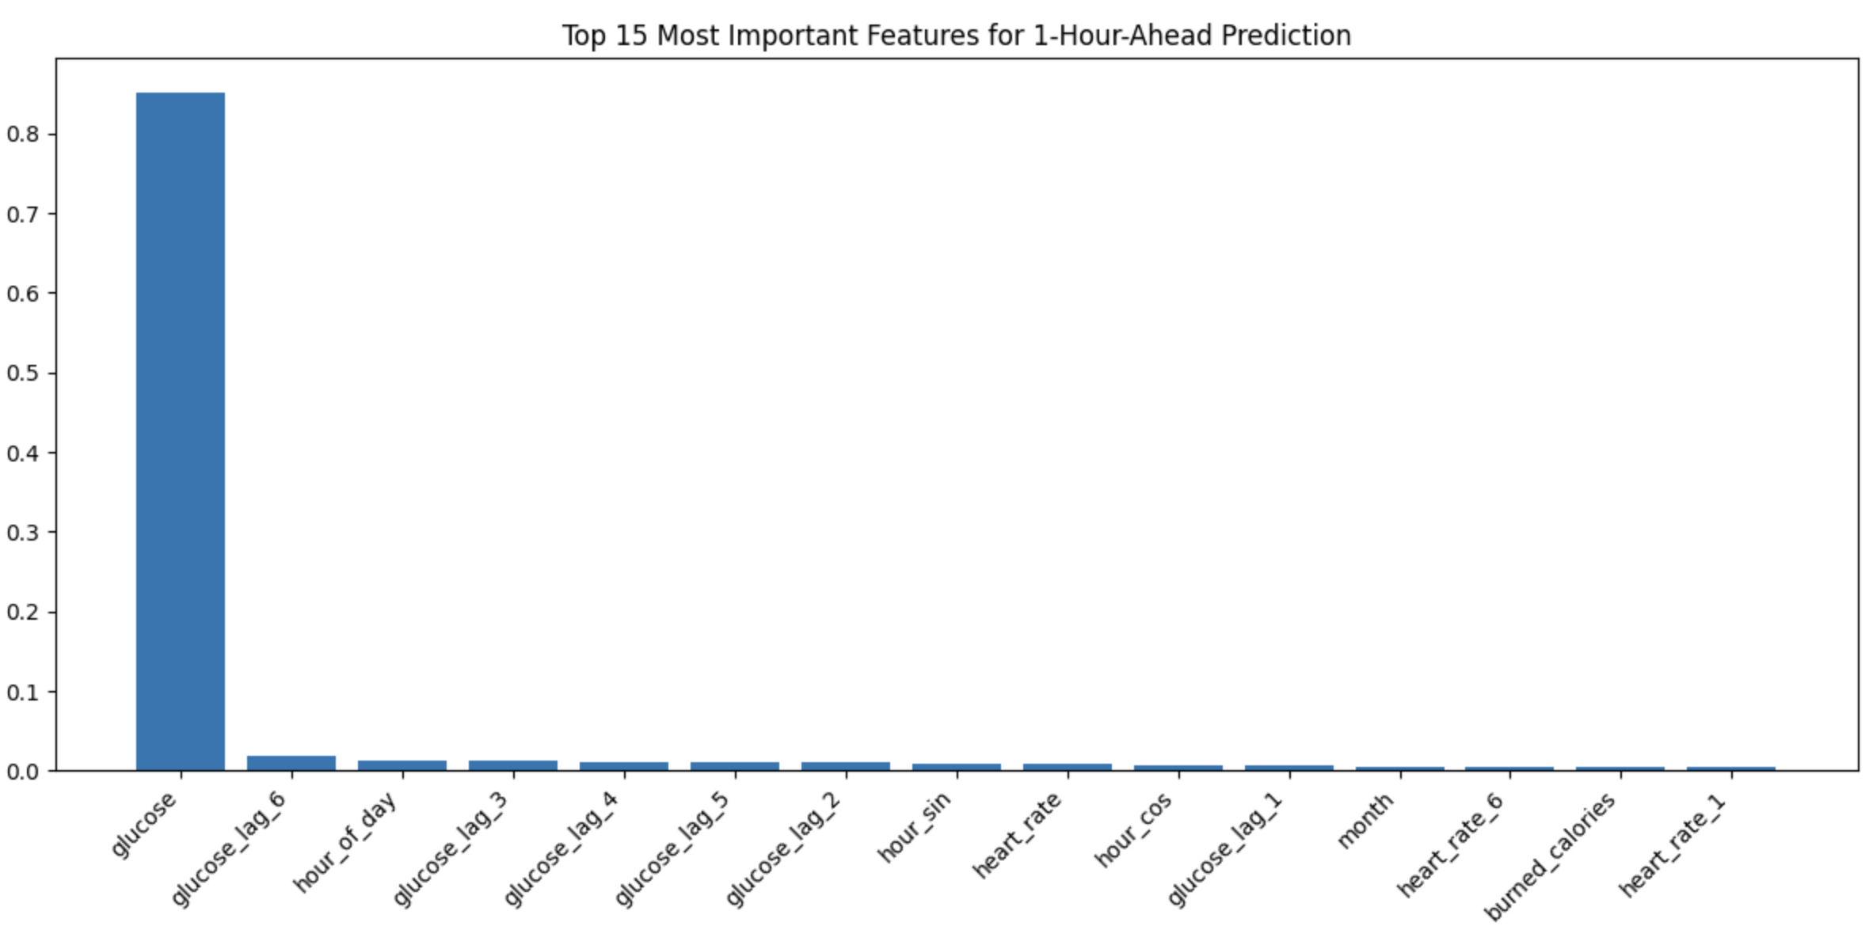
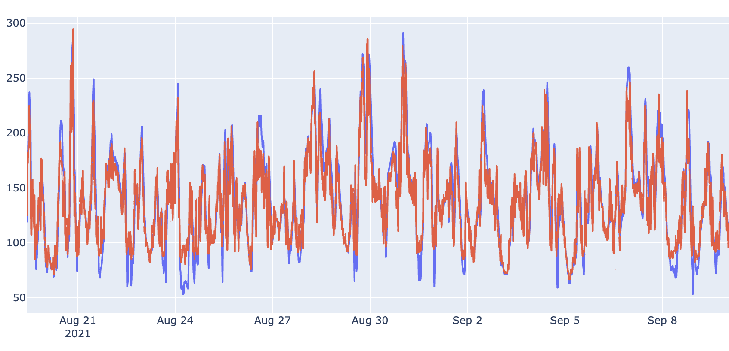
Random Forest
GridsearchCV:
param_grid = {
'n_estimators': [25, 50, 100],
'max_depth': [5, 10],
}
RF | RMSE | MAPE
Task 1a | 16.8 | 11.2%

Slide 24
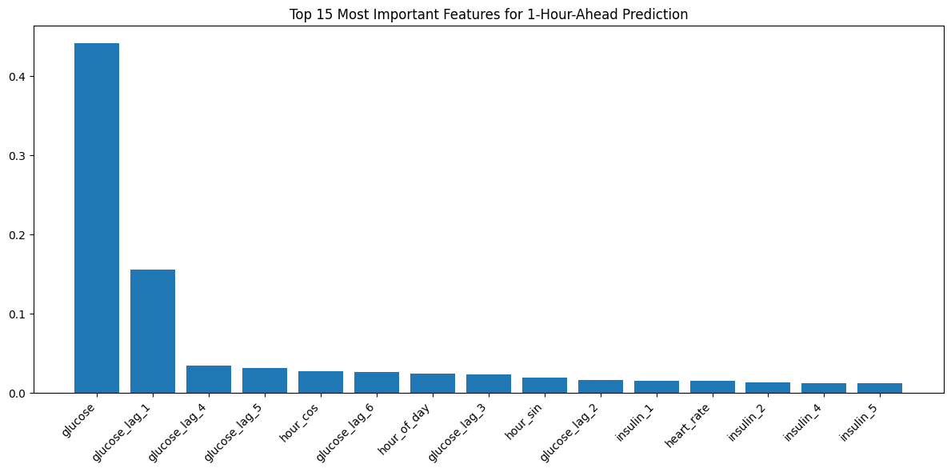
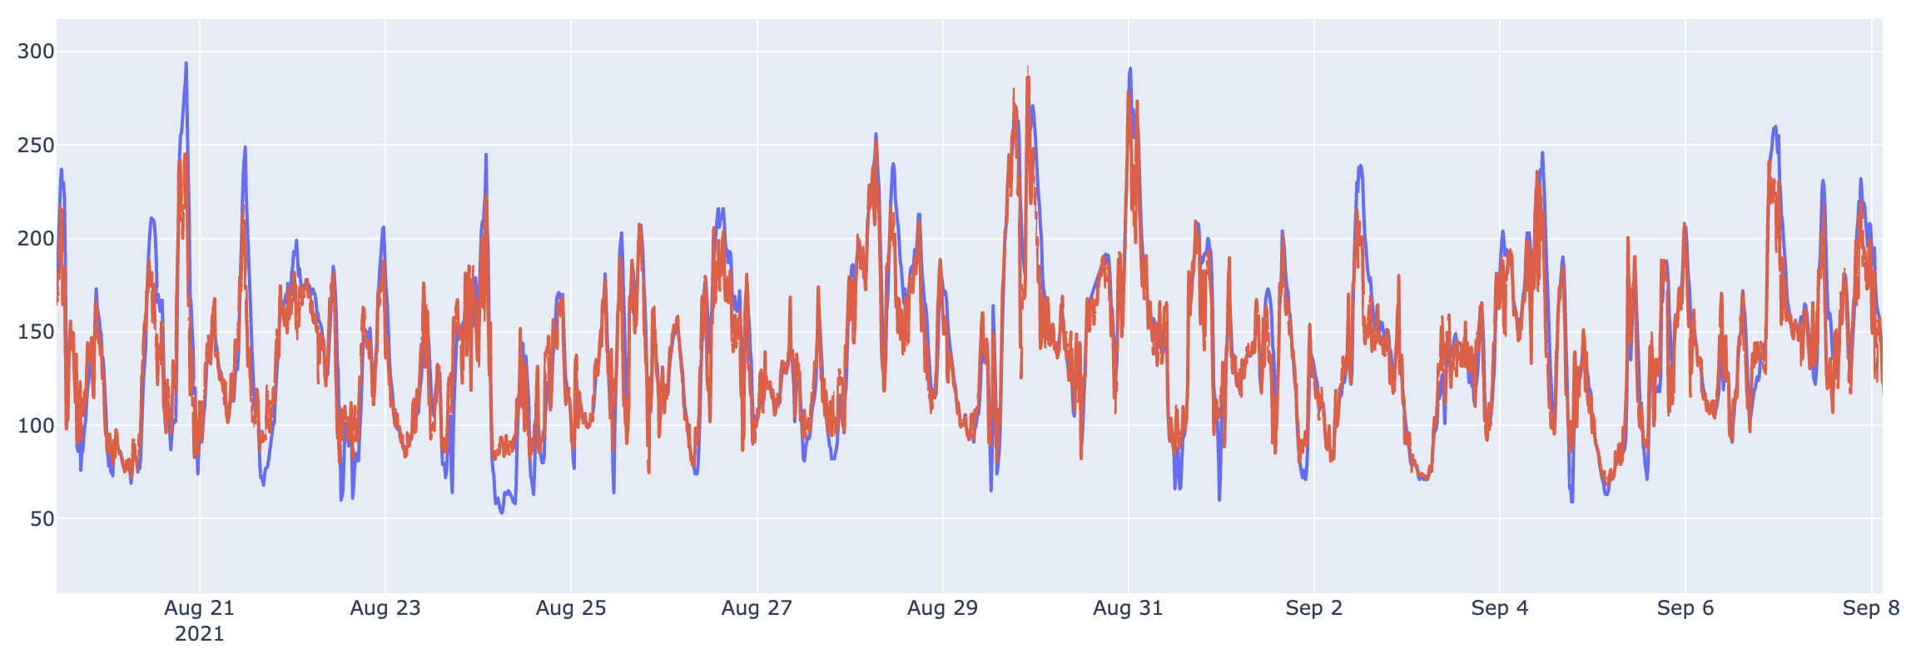
XGBoost
GridsearchCV:
param_grid = {
'n_estimators': [50, 100, 200],
'max_depth': [5, 10],
'subsample': [0.8, 1.0],
'colsample_bytree': [0.8, 1.0]
}
RF | RMSE | MAPE
Task 1a | 17.6 | 11.9%

Slide 25
Literature
Hidalgo et al., 2024: Dataset description
Azur, M. J., Stuart, E. A., Frangakis, C., & Leaf, P. J. (2011). Multiple imputation by chained equations: what is it and how does it work?. International journal of methods in psychiatric research, 20(1), 40–49. https://doi.org/10.1002/mpr.329

Slide 26
Model Definition and Evaluation
Discuss the models you've implemented, the feature engineering steps you've taken, and how you evaluated their performance. Include a screenshot of the code you used to implement the model.
3-4 slides
RNNs: GRU/LSTM
Tree models: Random Forest & Gradient boosting (XGBoost)
Tigramite: Causal analysis
N-Beats / N-Hits

Slide 27
Recurrent Neural Networks
LSTM
GRU

Slide 28
Modern Deep Learning Architectures
N-Beats / N-Hits

Slide 29
Chronos
Pretrained foundation model for TS
Zero-shot application
Fine-Tuning
Zero-shot | RMSE | MAPE
Task 1a | 25.0 | 15.3%
Zero-shot | RMSE | MAPE
Task 1a | 25.0 | 15.3%

Slide 30
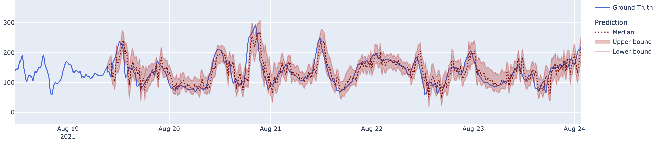
Chronos – zero shot results
Zero-shot | RMSE | MAPE
Task 1a | 25.0 | 15.3%

Slide 32
Result overview
Present the results in a clear and easy-to-understand format. Use tables, charts, or any other visual aids that you find appropriate.
2-3 slides

Slide 33
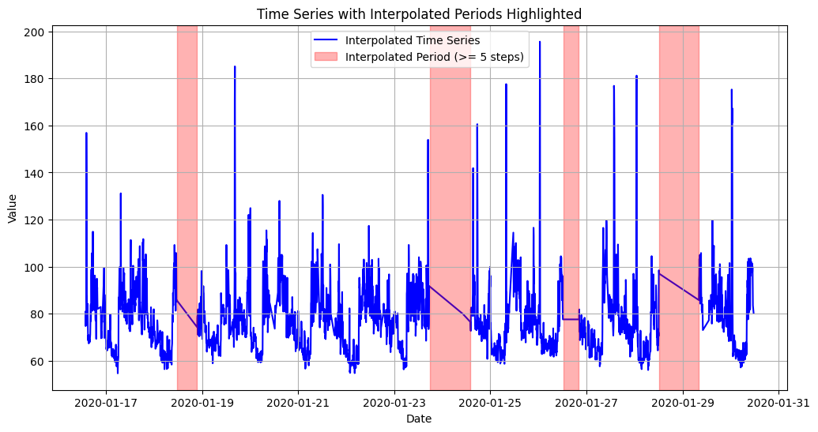
Challenges and Errors
Discuss the most challenging issue or error you encountered during the data preparation or modeling phase, and how you overcame it.
Missing data: Preprocessed data linearly interpolated for all missing dates

Slide 34
Discussion
Reflect on the performance of your models compared to the baseline, and discuss any limitations and future work.
1-2 slides

Slide 35
Outlook
Anthropometrics (age, gender, height, etc.)
Sleep?

Slide 36
Q&A

